Slide 1

Sports Club Management
Vedant Parulekar (21107034)
Vanshika Salve (21107010)
Sanchit Patil (21107001)
Ekta Panchal (21107049)
Project Guide
Ms.Poonam Pangarkar

Slide 2
Contents
Introduction
Objectives
Scope
Features
Project Outcomes
Technology Stack
Block Diagram

Slide 3
1. Introduction
Sports Club Management is a system that provides and manages various club activities and different Indoor & Outdoor Sports
Problem Identified :
Organization of workload becomes hefty and inconvenient
Keeping the data only on paper is no longer an option
Solution Proposed :
The system is easy to use and saves human efforts and cost
The system stores enrollment details of all the users

Slide 4
2. Objectives
To provide a healthy sporting habit among the people.
To promote and develop interest in a particular sport or physical activity
To improve skills and enhance employability.
To build sportsmanship.

Slide 5
3. Scope
Sports management involves handling all the aspects of sport teams, athletes, sportsperson, sports events.
Sports management is required at all levels where sports are played from schools to colleges and from local to national and national to international levels

Slide 6
4. Features
Various Indoor & Outdoor sports membership available.
Weekly updates about ongoing and upcoming events in notice section.
Admin can access the details of enrolled user.
Schedule of all the sports and faculty members available

Slide 7
5. Project Outcomes
Admin:
Login
Directed to the enrolled user page
Notice & event
Enrolled User:
Login
Main Page
Check notice or event
Check the schedule
New User:
- Register

Slide 8
6. Technology Stack
1. NetBeans (version 8.2)
2. Jdk (version 19.0.1)
3. MySQL (version 8.0.3.0)

Slide 9
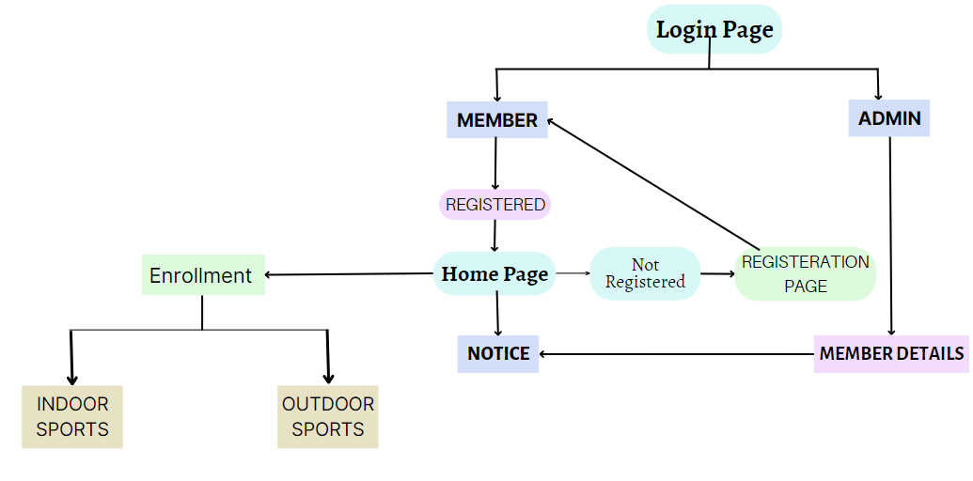
7. Block Diagram

Slide 10
Thank You...!!

